Slide 1

Booking Cancellation prediction using ML Algorithm
By
B,Sana Reddy
119ec0014

Slide 2
Agenda
Problem Statement
Given Data
Visualisation
Steps done
Chosen Model
Conclusion

Slide 3
Problem Statement
Cancellation Prediction problem:
We should be able to determine whether a resident will cancel the reservation using the provided information on hotel bookings for a certain hotel.
We can anticipate the cancellation status by using a binary classifier containing information on the lead time, agent, customer type, etc.

Slide 4
Given Data: Number of cancelled hotel bookings(Data Set) and Data types
https://raw.githubusercontent.com/Premalatha-success/Datasets/main/hotel_bookings.csv

Slide 5
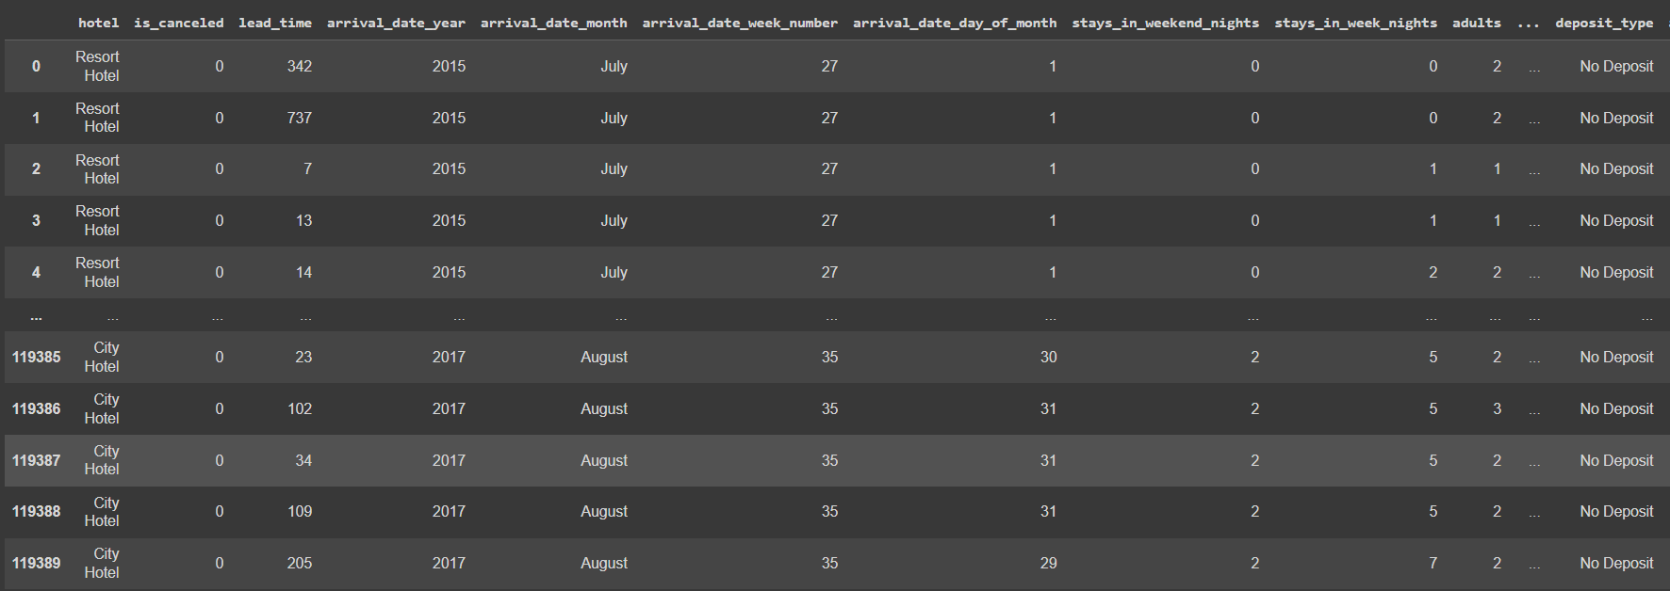
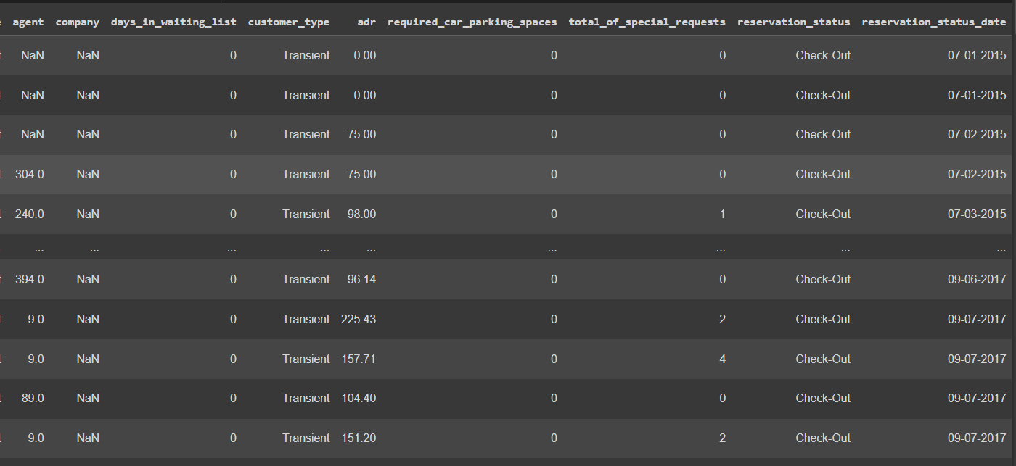
Data Set

Slide 6

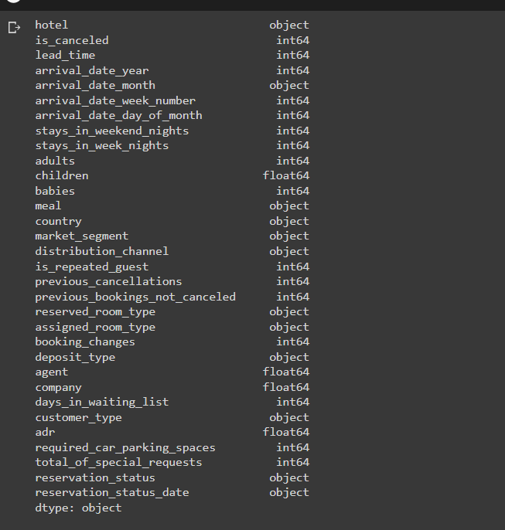
Data Types

Slide 7
Visualisation

Slide 8
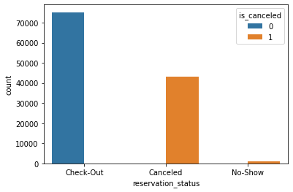
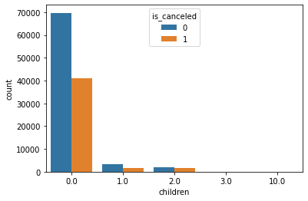
Visualising feature to feature

Slide 9
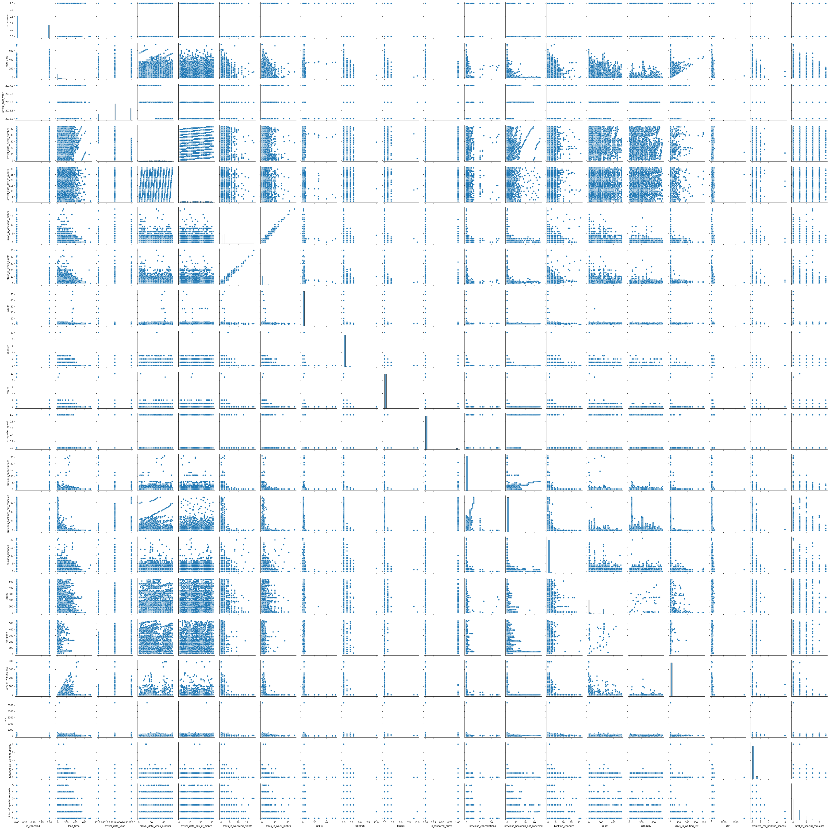
Pair Plot

Slide 10
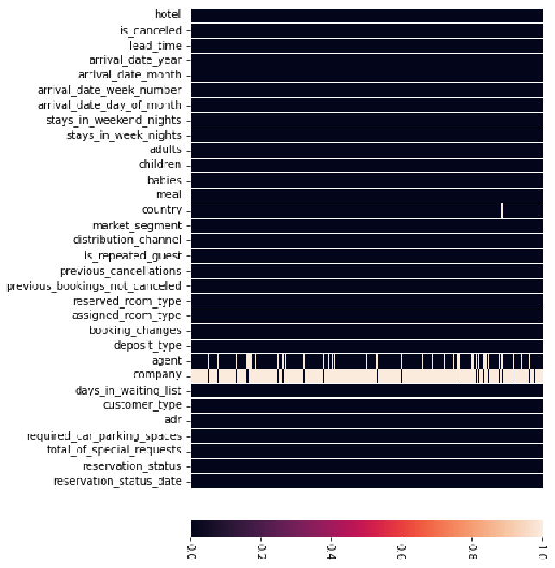
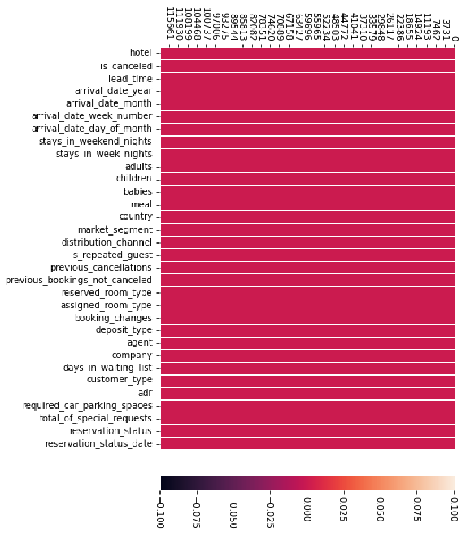
Visualising Null Values

Slide 11
STEPS
Import the packages such as numpy, pandas, matplotlib, seaborne, sklearn, train-test split metrics
Load the data set
Explore the data-shape and visualisation
Fit the model with training data and predict the test data results.
Choose the accurate(100%) model for the data

Slide 12
Chosen Model:(Decision Tree)
Among the five algorithms(Logistic Regression, SVM(support vector machine), KNN(K-Nearest Neighbour), Naïve Baye's and Decision Tree) chosen, the accuracy of Decision Tree algorithm is 100% compared to the other four algorithms
So, the chosen model is Decision Tree algorithm

Slide 13
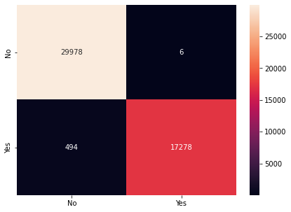
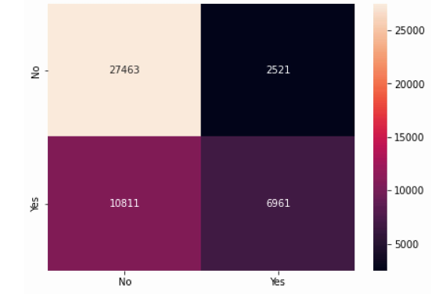
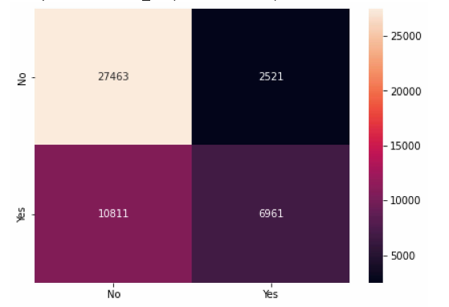
Confusion Matrices
Logistic Regression
SVM
K-nearest neighbours

Slide 14
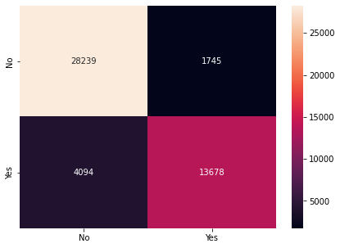

Confusion Matrices
Naïve Baye's
Decision Tree

Slide 15
Conclusion
After the visualisation of features in the data set by using training data and test data, the accuracy and precision of fve
algorithms are different.They are:
Logistic Regression:
Training data:0.9899209872406958
Testing data:0.9895301113996147
SVM:
Training data:0.7242231342658514
Testing data:0.7208308903593266

Slide 16
K-nearest neighbours:
Training data:0.9159756540190412
Testing data:0.8777326409247006
Naïve Baye's:
Training data:0.9928385961973365
Testing data:0.9930898735237457
Decision Tree:
Training data:1.0
Testing data:1.0

Slide 17
Thank you
B.Sana Reddy
119ec0014

